Slide 1
Shrinkage Methods for Variable Selection
“Statisticians, like artists, have the bad habit of falling in love with their models.”
-George Box

Slide 2
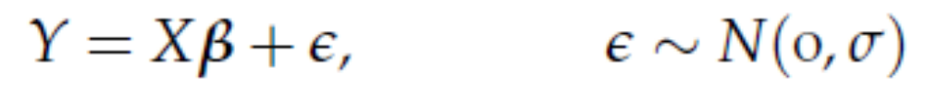
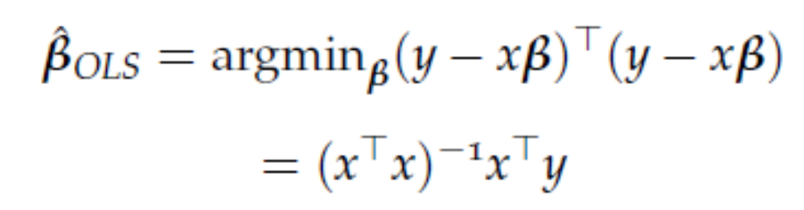
Ordinary Least Squares
Linear Model:
Minimize Sum of Squares due to Errors

Slide 3
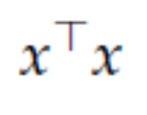
Limitations
Decompose error into bias and variance term, linear regression focuses on bias and suffers from high variance. Bias variance trade-off.
Unstable, variance inflation with large number of predictors, specially correlated predictors.
Inverting becomes problematic.

Slide 4

Ridge Regression (Hoerl and Kennard, 1988)
Very much like least squares but minimizes a loss function + penalty term
Adding to the diagonals of the matrix to make inversion possible.
Shrinks coefficients to zero

Slide 5

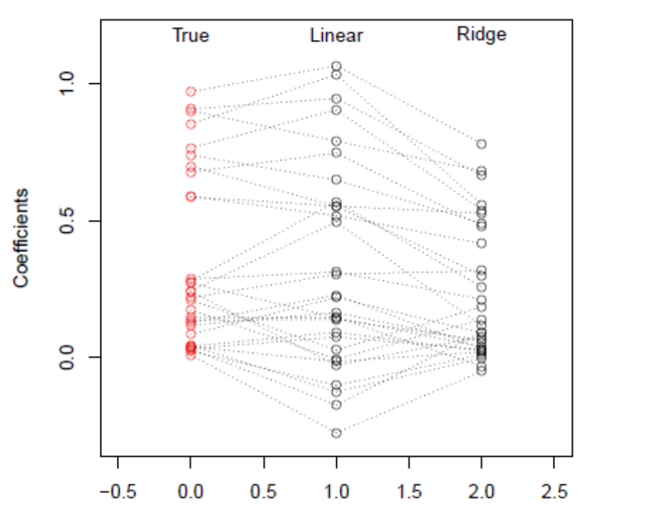
N=50, p=30, 10 large and 20 small coefficients
http://www.stat.cmu.edu/~ryantibs/datamining/lectures

Slide 6


Tuning Parameter
Here is a tuning parameter which controls how much you penalize.
When is zero, you get back linear regression.
When what happens?
In between values of does the balancing act. Bias increases and variance decreases as increases.
You will center and scale the predictors before doing ridge regression

Slide 7
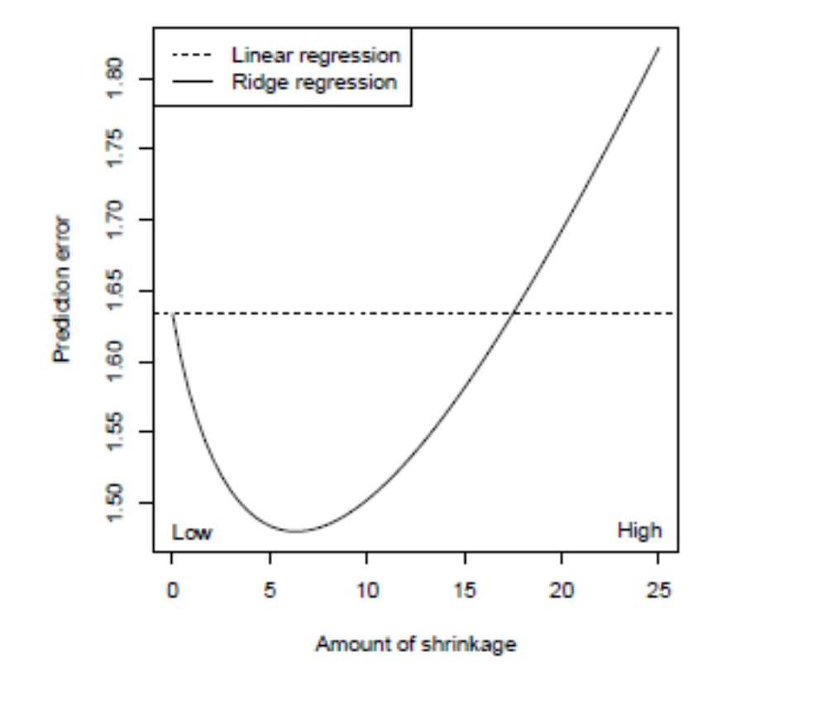
Optimal amount of shrinkage
http://www.stat.cmu.edu/~ryantibs/datamining/lectures

Slide 8

How to choose the tuning parameter?
This is actually a hard question
Golub et al (1979) proposed to use generalized cross-validation to select
GCV is a weighted modification of ordinary leave 1 out cross validation (like PRESS)
It has certain asymptotic optimality properties (Craven and Wahba, 1979)
In R: library(MASS) function lm.ridge
Or look at library(glmnet)

Slide 9
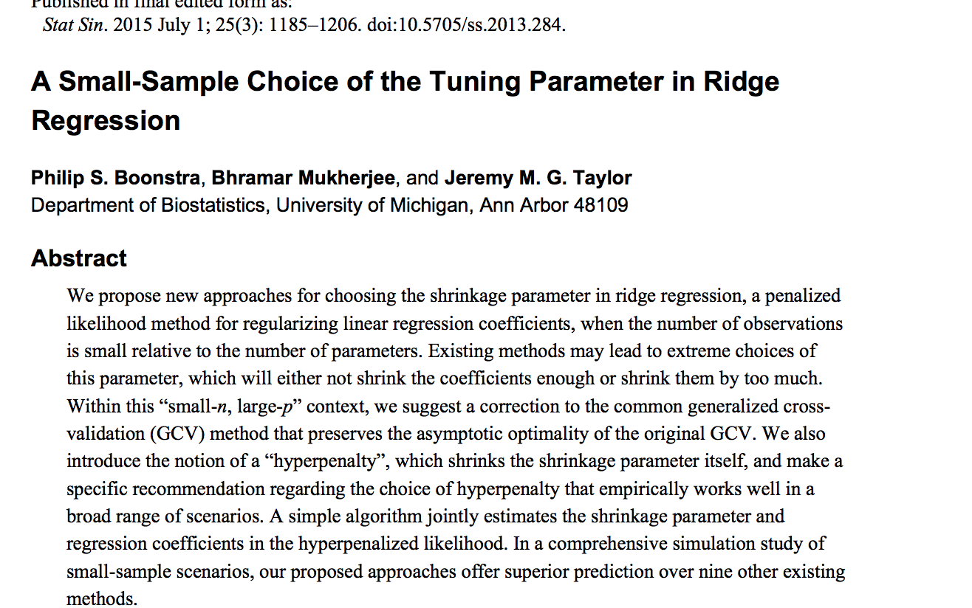
Ubiquitous and Daunting

Slide 10

Variable Selection
Suppose there is a group of variables where the true coefficient is really zero.
Identifying relevant predictors from a larger set is defined as variable selection
Ridge does not perform variable selection
In the case when some coefficients are truly zero, ridge can still outperform linear regression for a narrower range of
You really wanted to identify a subset…

Slide 11
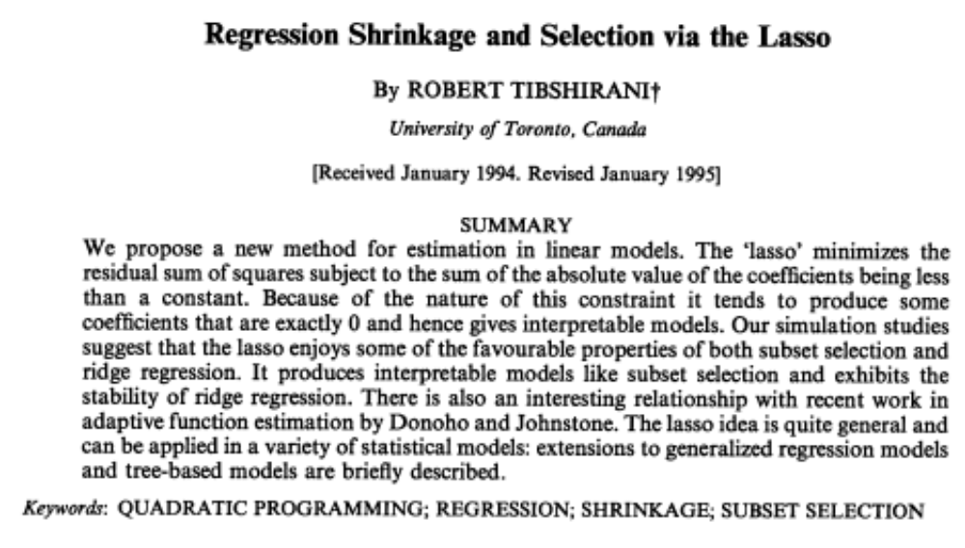
A landmark paper (1996)

Slide 12

Shrinking coefficients to zero
Instead of the sum of squares of betas or the L₂ norm, use L₁ norm in the penalty
LASSO: Least absolute shrinkage and selection operator.

Slide 13
Tuning Parameter
Here is a tuning parameter which controls how much you penalize.
When is zero, you get back linear regression.
When what happens?
In between values of does the balancing act. Bias increases and variance decreases as increases. Some betas shrunk to zero.
You will center and scale the predictors before doing LASSO

Slide 14
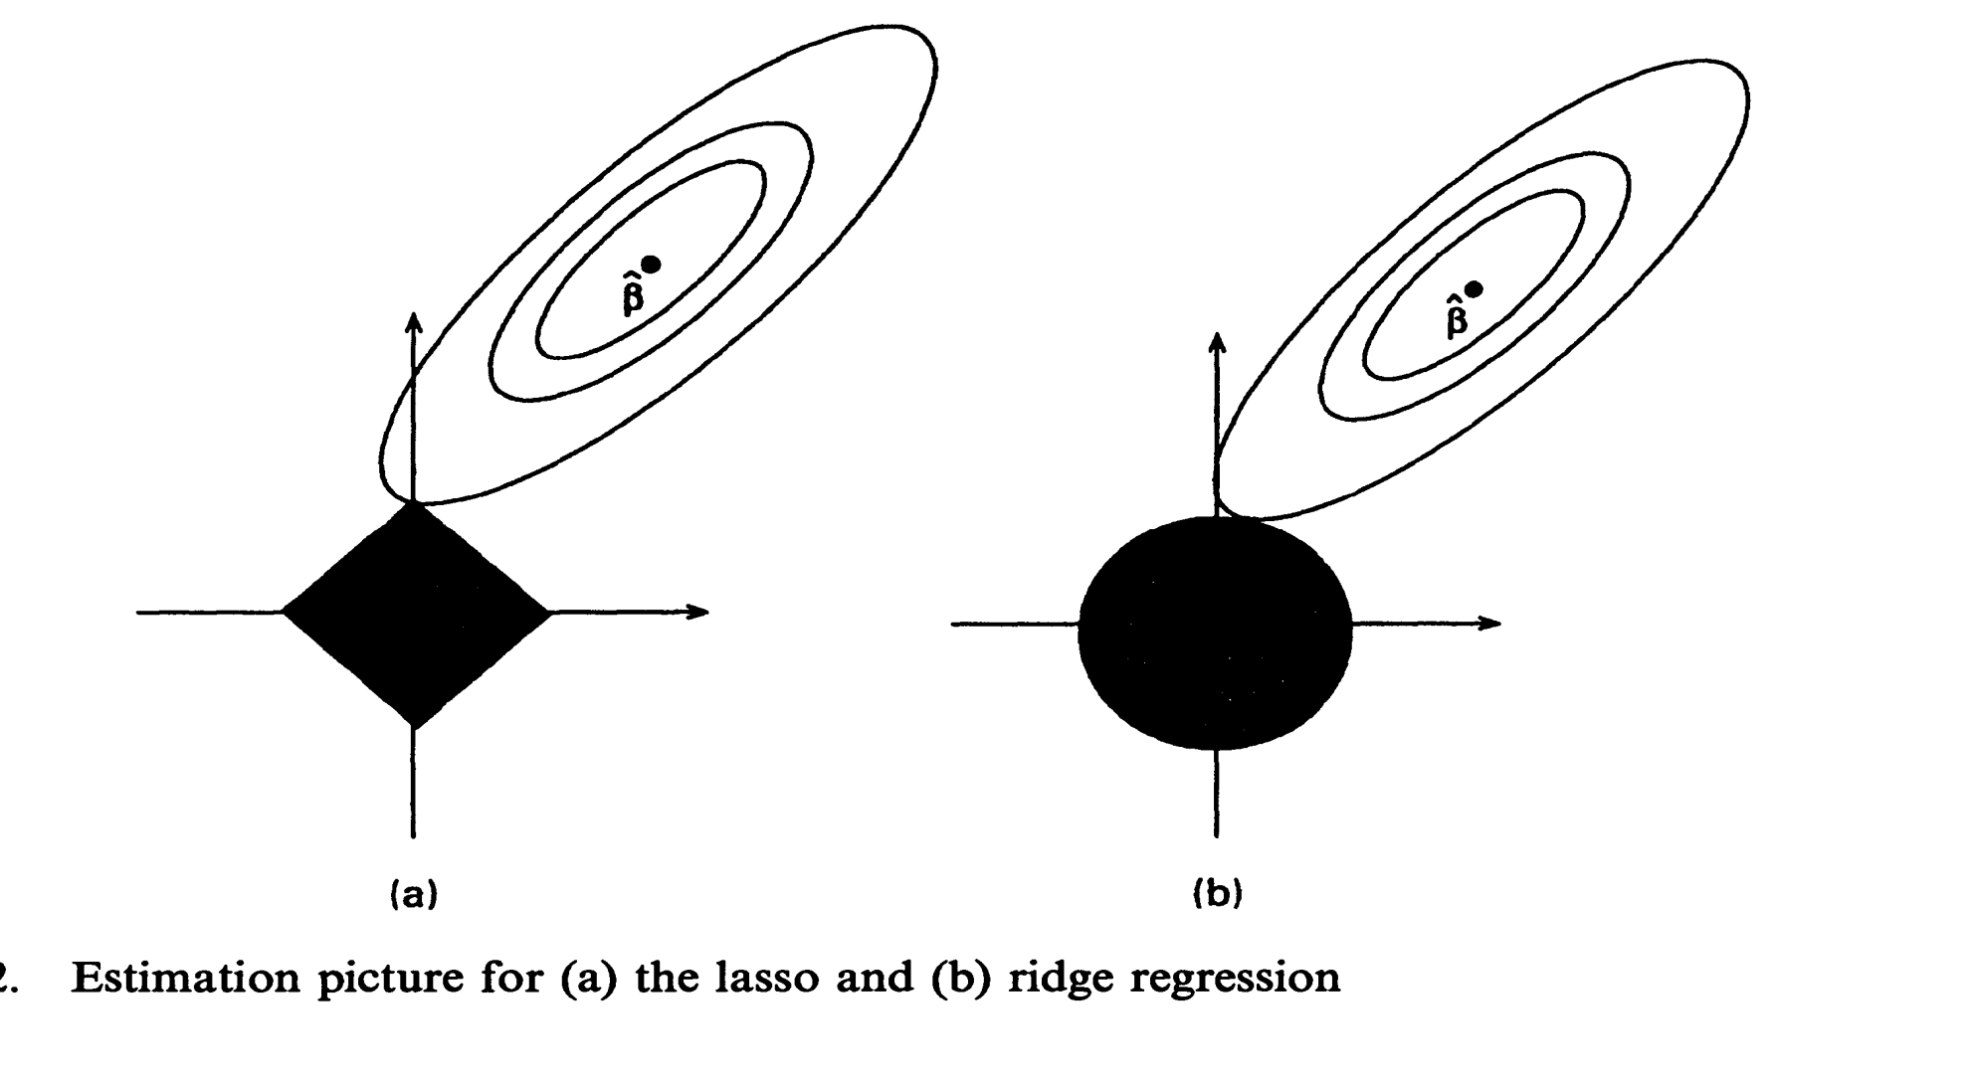
Why LASSO shrinks coefficients to zero and can perform variable selection
You can touch the contour ellipse for the first time at a corner of the square, corresponding to a zero coefficient. In ridge there are no corners for the contour to hit, zero solutions will rarely result.

Slide 15
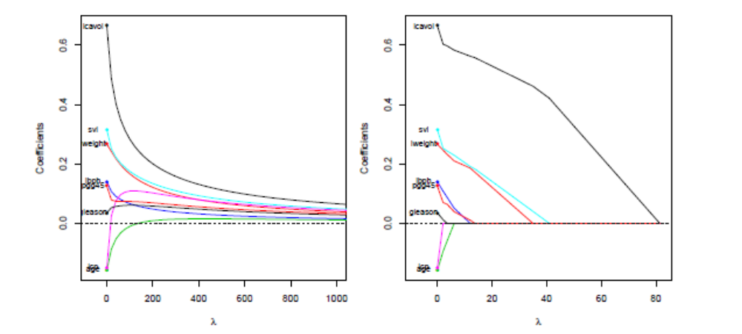
Ridge versus LASSO in a sample dataset: note
Coefficients go to zero as increases.

Slide 16
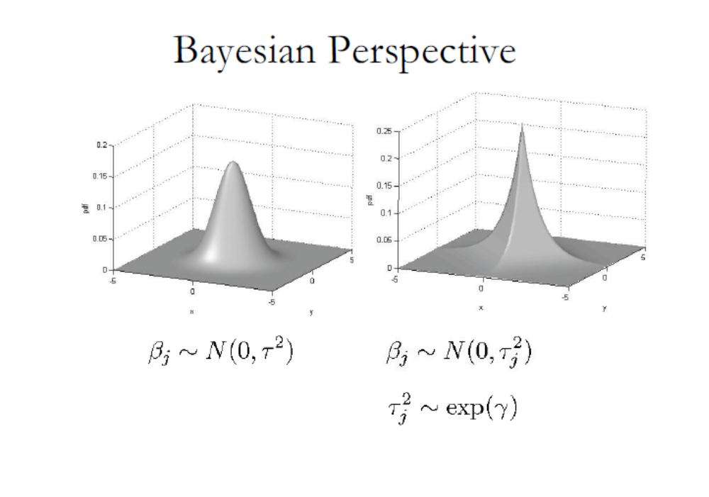

Slide 17
R implementation
library('gcdnet')
set.seed(0)# set up the random-number-generator seed for cross validation (CV)
cv.lasso<-cv.gcdnet(x,y,lambda2=0,method="ls")#The default is 5-fold CV
plot(cv.lasso) # the CV error plot

Slide 18
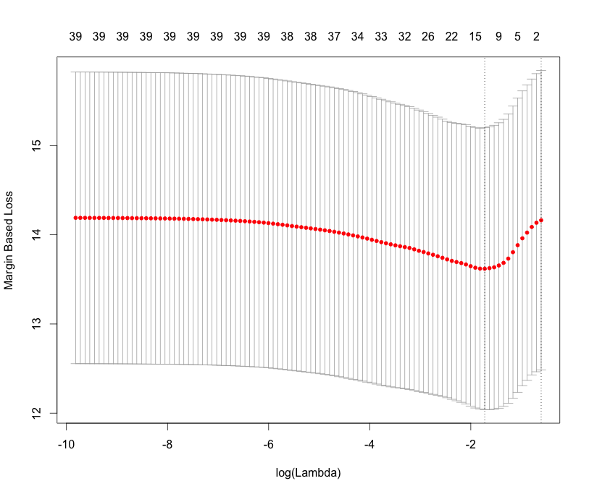

Slide 19
Choosing optimal lambda by CV
cv.lasso$lambda #the values of the candidate lambda
log(cv.lasso$lambda)#the values of log(lambda) lambda.opt=cv.lasso$lambda.min#value of lambda that gives minimum mean cross-validated error
lambda.opt
[1] 0.178
Implement LASSO with this chosen optimal value
fit.lasso=gcdnet(x,y,lambda=lambda.opt,lambda2=0,method="ls")
beta.lasso=coef(fit.lasso)# get the coefficients
#beta.lasso
order=order(abs(beta.lasso),decreasing = TRUE)# sorted by absolute value of beta in decreasing order
beta.lasso=data.frame(beta=beta.lasso[order],row.names=rownames(beta.lasso)[order])
beta.lasso

Slide 20
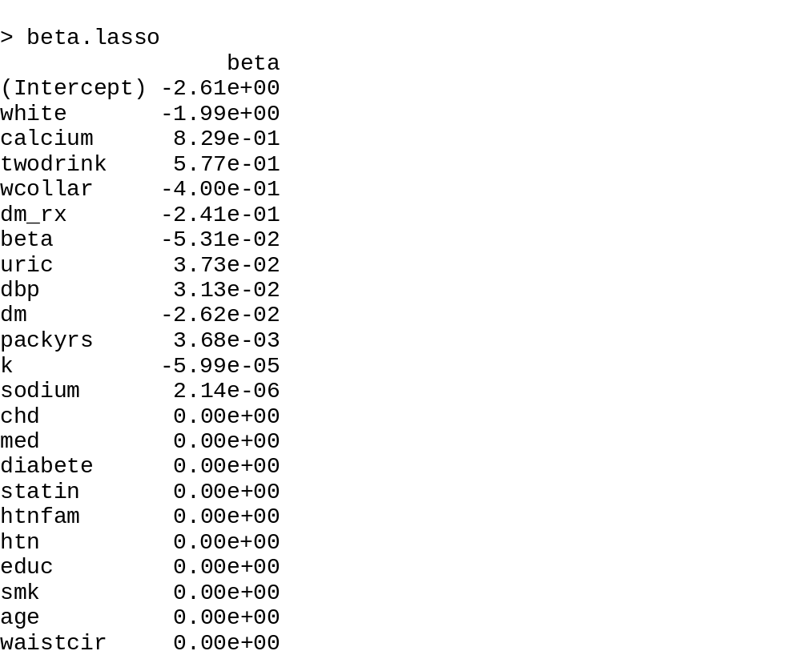

Slide 21
Elastic Net (Zou and Hastie, 2005)
LASSO does not do very well for a correlated set of predictors and when p much larger than n.
If there is a group of predictors with high pairwise correlation, LASSO tends to select only one from the group and does not care which one it is.
Prediction performance of LASSO not satisfactory with highly correlated set of predictors, dominated by ridge.

Slide 22

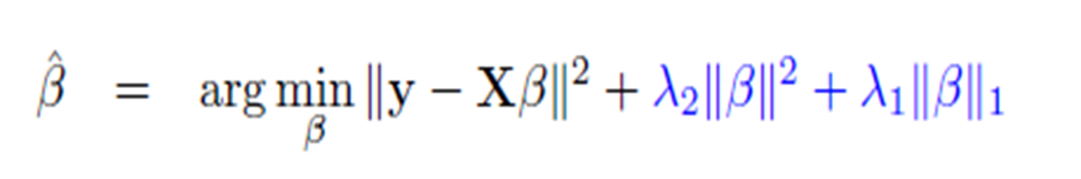


Modify LASSO to fix this
LASSO and Ridge Regression are special cases

Slide 23

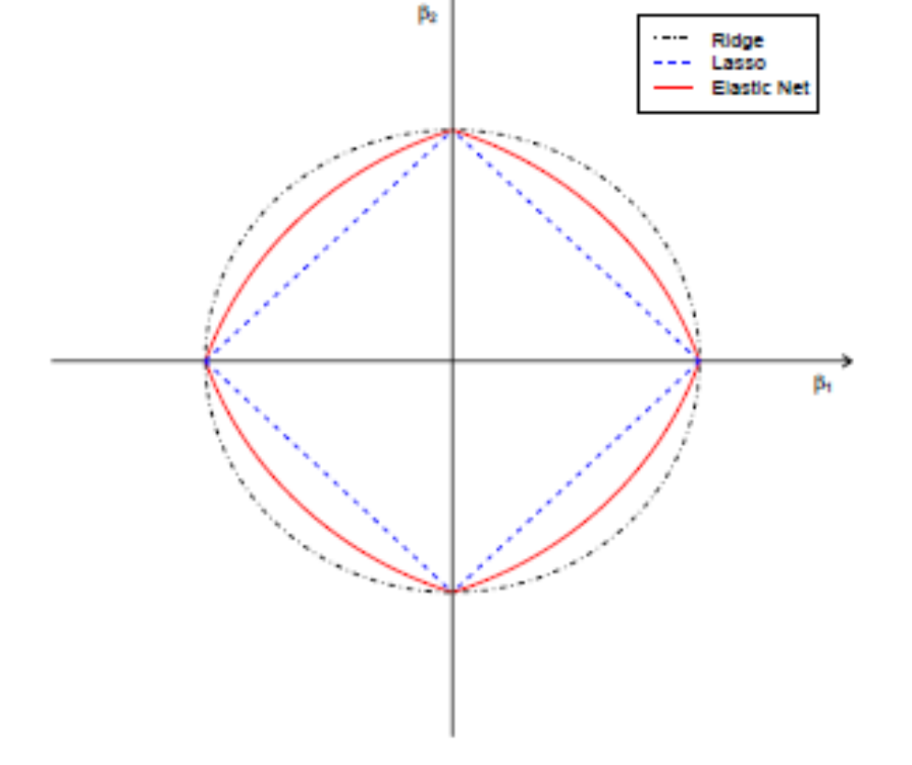
Elastic Net
Combining L1 and L2 penalties
R package GLMNET GCDNET
SAS GLMSELECT
(only linear models)

Slide 24
LASSO vs ENET
ENET beats LASSO in presence of collinearity in terms of prediction error
Produces larger models than LASSO
Produces sparse models with good prediction accuracy while encouraging grouping effect.

Slide 25
R implementation
num.obs=nrow(x)#the number of observations;
set.seed(0) # set up a seed for the random number generator "sample“
foldid=sample(rep(seq(5),length=num.obs))# this is to make sure lambda2 is cross-validated by the same training/validation sets
# 5 means we do 5-fold cross validation which is default in gcdnet

Slide 26
Choose lambda2 first
lambda2.list=seq(0.01,2,by=0.01) #candidate lambda2
num.lambda2=length(lambda2.list) #the number of candidate lambda2
min.cv=numeric(num.lambda2)

Slide 27
#cross validation for each candidate lambda2
for(i in 1:num.lambda2)
{cv.enet=cv.gcdnet(x,y,foldid=foldid,lambda2=lambda2.list[i],method="ls") # lambda (for L1 penalty) will be automatically generated by default setting
min.cv[i]=min(cv.enet$cvm) #collect minimum cv error for each lambda2 candidate}

Slide 28
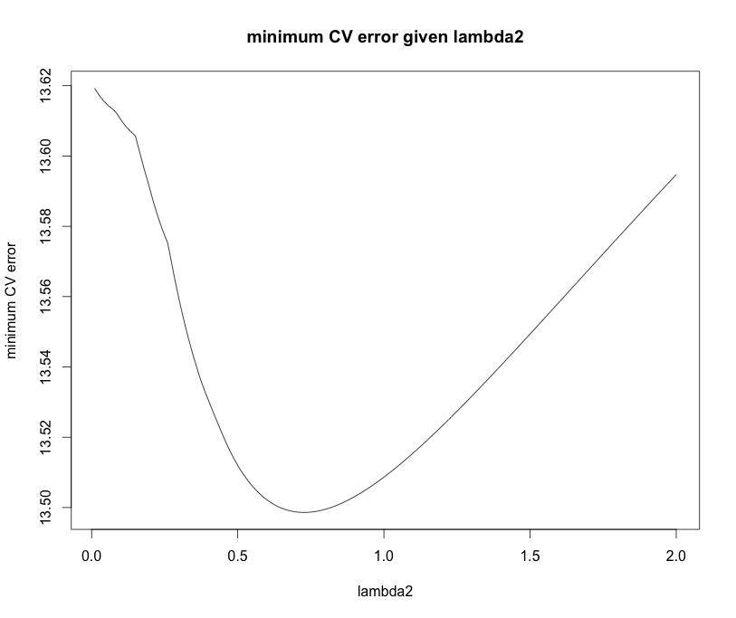
plot(lambda2.list,min.cv,xlab="lambda2",ylab="minimum CV error",main="minimum CV error given lambda2",type='l')

Slide 29
lambda2.opt=lambda2.list[which.min(min.cv)] #optimal lambda2 that has the minimum CV error
lambda1.list=cv.enet$lambda #candidate lambda (for L1 penalty)
#cross validation for lambda1 given the optimal lambda2
cv.enet=cv.gcdnet(x,y,foldid=foldid,lambda2=lambda2.opt,method="ls")
plot(cv.enet) #CV error given lambda1 and the optimal lambda2

Slide 30
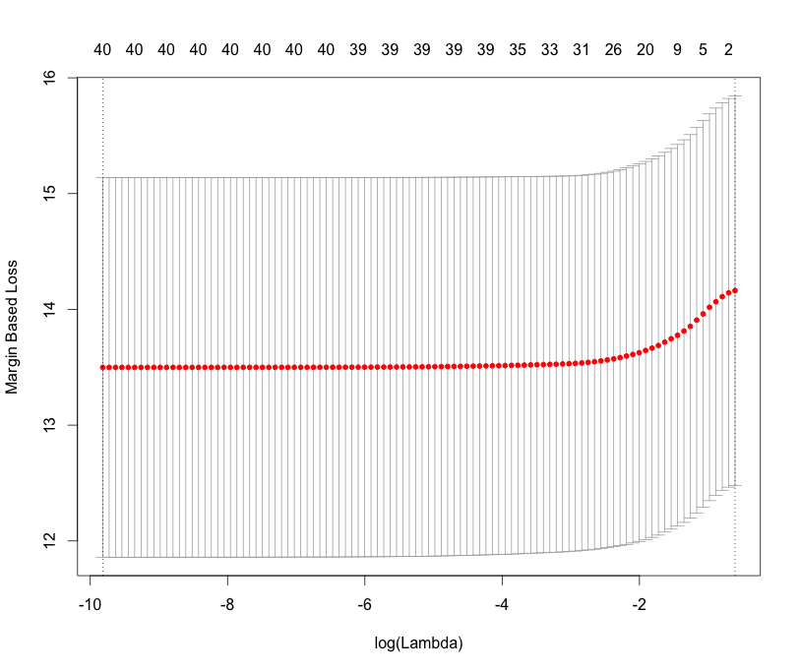
plot(cv.enet) #CV error given lambda1 and the optimal lambda2

Slide 31
#try lambda=exp(-1.5)
fit.enet=gcdnet(x,y,lambda=exp(-1.5),lambda2=lambda2.opt,method="ls")
beta.enet=coef(fit.enet)# get the coefficients
order=order(abs(beta.enet),decreasing = TRUE)# sorted by absolute value of beta in decreasing order
beta.enet=data.frame(beta=beta.enet[order],row.names=rownames(beta.enet)[order])

Slide 32
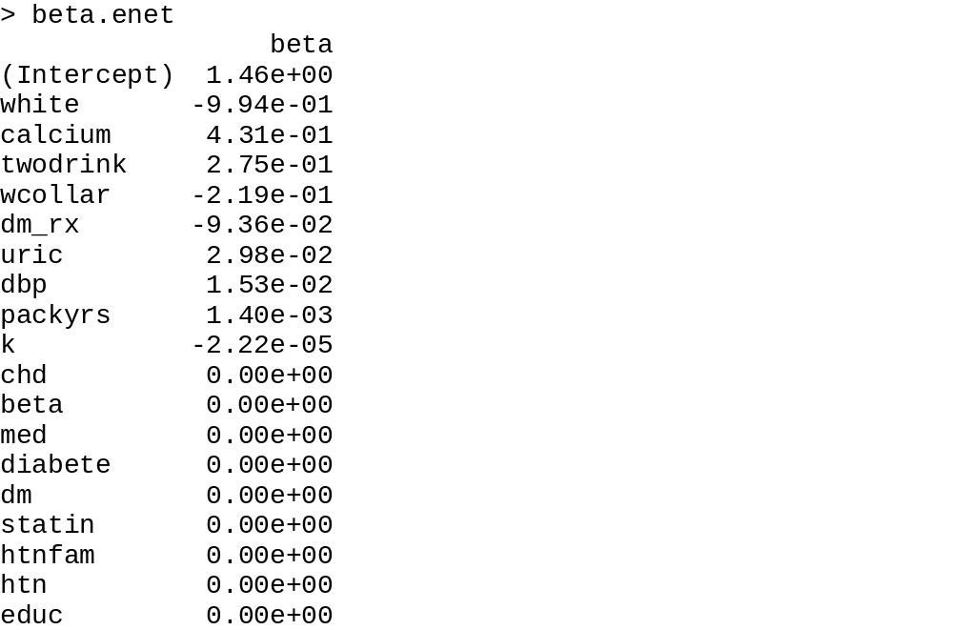
Sample coefficient vector

Slide 33
Adaptive LASSO and ENET
We have just been getting beta vectors
What about CI for beta? P-value for testing?
Often people will choose variables with non-zero coefficients and go back to run the usual linear model. Incorrect!
Inference post model selection is hard!

Slide 34
Zou and Zhang (2009)
Use a weighted L₁ penalty.
An asymptotic result that produces standard error and p-values for each non-zero estimated coefficient.
Adaptive LASSO is a special case of adaptive ENET by forcing lambda2=0.

Slide 35
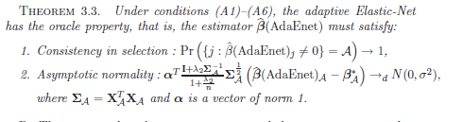
Math and more math: useful

Slide 36


Adaptive ENET
We choose the initial estimates by regular ENET
R codes for getting Adaptive ENET and Adaptive
LASSO p-values and std errors are complicated
and are provided in the R code folder

Slide 37
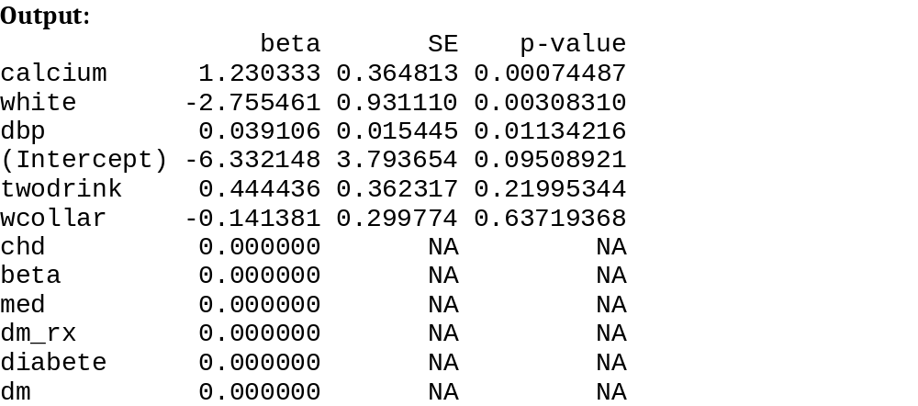
After a chain of complex R codes
Adaptive LASSO inference

Slide 38
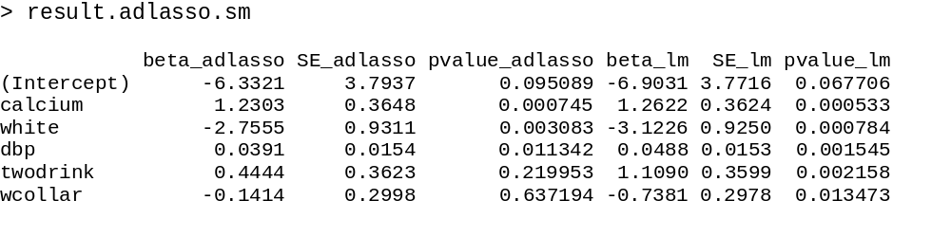
Comparing with OLS on selected predictors
Note much larger P-values for the last two predictors using Adaptive
LASSO inference rather than running linear model for predictors with
non-zero coefficients

Slide 39
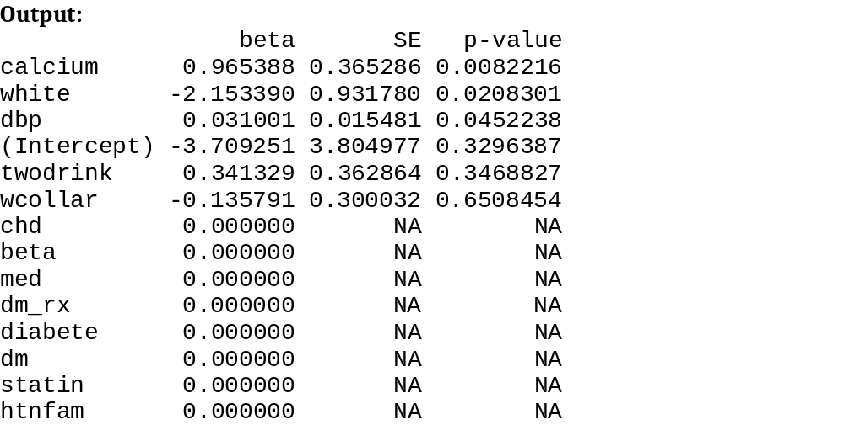
Adaptive ENET on same data
Adaptive ENET inference

Slide 40
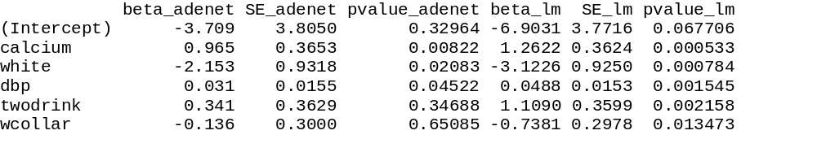
Comparison with OLS
Note much larger P-values for the last two predictors using Adaptive
ENET inference rather than running linear model for predictors with
non-zero coefficients

Slide 41
Moral of the story
You just went through a very dense lecture
Regularized variable selection with penalty terms is a new area of research where a lot of the things including how to do post model selection inference are still evolving.
These are very useful tools when there truly exists a small subset of important predictors (sparsity).

